Slide 1
Motion & Activity
Slides Acknowledgements
Steve Seitz
Kirsten Grauman, Vassilis Athitsos
Other Vision Researchers
Ebook: R. Szeliski

Slide 2
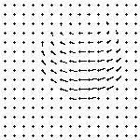
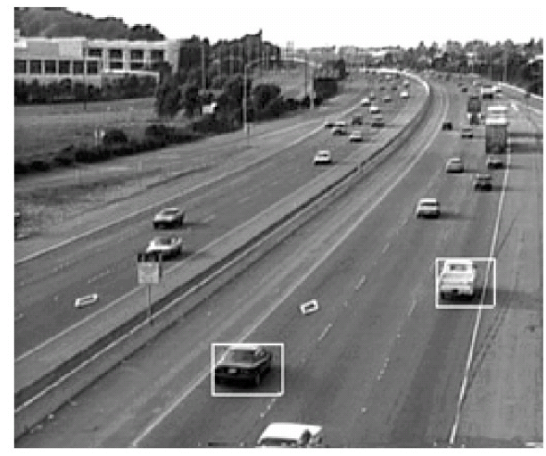
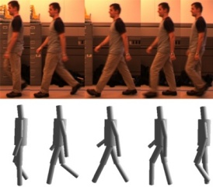
Motion and tracking
Tracking objects, video analysis, low level motion
Tomas Izo

Slide 3
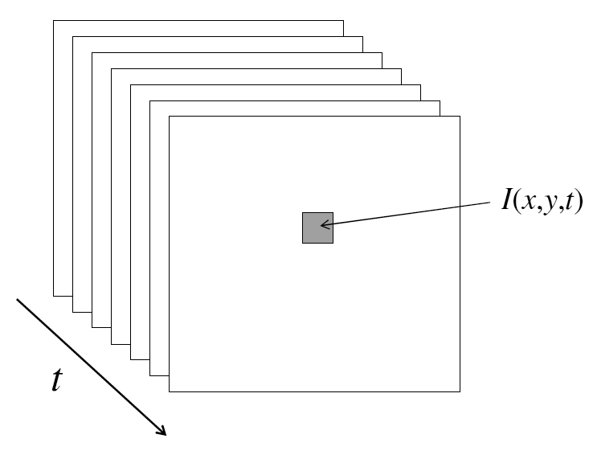
Video
A video is a sequence of frames captured over time
Now our image data is a function of space (x, y) and time (t)

Slide 4
Uses of motion
Estimating 3D structure
Segmenting objects based on motion cues
Learning dynamical models
Recognizing events and activities
Improving video quality (motion stabilization)

Slide 5
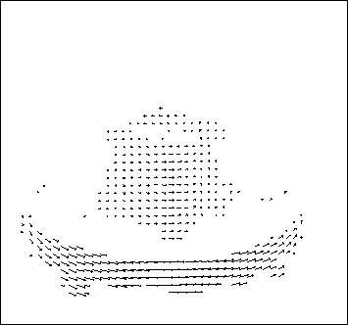
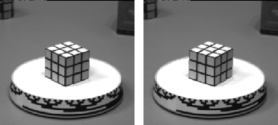
Motion field
The motion field is the projection of the 3D scene motion into the image

Slide 6
Motion parallax
http://psych.hanover.edu/KRANTZ/MotionParallax/MotionParallax.html

Slide 7
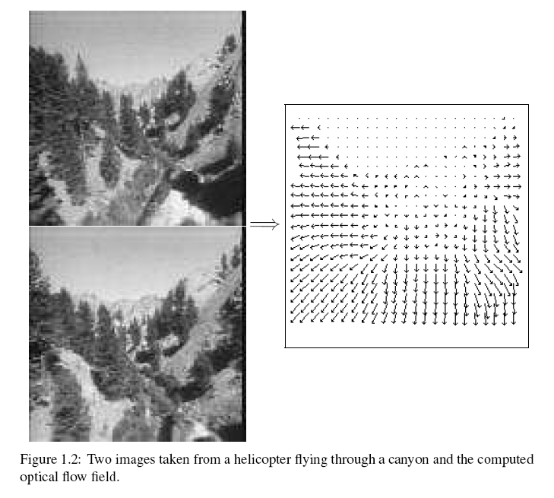
Motion field + camera motion
Length of flow vectors inversely proportional to depth Z of 3d point
points closer to the camera move more quickly across the image plane
Figure from Michael Black, Ph.D. Thesis

Slide 8
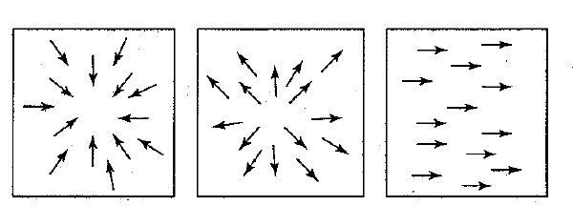
Motion field + camera motion
Zoom out
Zoom in
Pan right to left

Slide 9
Motion estimation techniques
Direct methods
Directly recover image motion at each pixel from spatio-temporal image brightness variations
Dense motion fields, but sensitive to appearance variations
Suitable for video and when image motion is small

Slide 10
Motion estimation techniques
Feature-based methods
Extract visual features (corners, textured areas) and track them over multiple frames
Sparse motion fields, but more robust tracking
Suitable when image motion is large (10s of pixels)

Slide 11
Optical flow
Definition: optical flow is the apparent motion of brightness patterns in the image
Ideally, optical flow would be the same as the motion field
Have to be careful: apparent motion can be caused by lighting changes without any actual motion

Slide 12
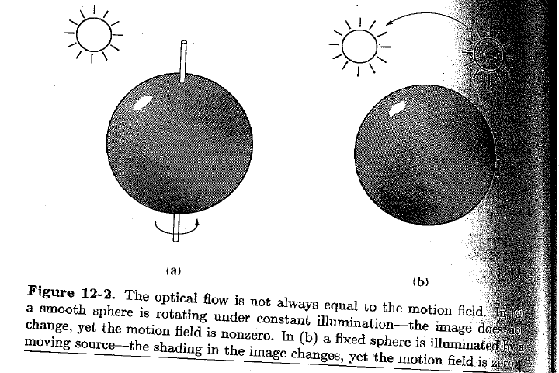
Apparent motion != motion field
Figure from Horn book

Slide 13
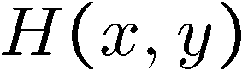

Problem definition: optical flow
How to estimate pixel motion from image H to image I?
Solve pixel correspondence problem
given a pixel in H, look for nearby pixels of the same color in I
Key assumptions
color constancy: a point in H looks the same in I
For grayscale images, this is brightness constancy
small motion: points do not move very far
This is called the optical flow problem
Steve Seitz

Slide 14
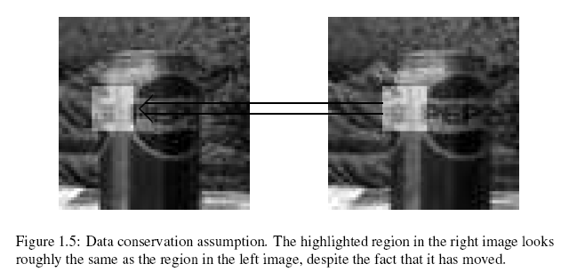
Brightness constancy
Figure by Michael Black

Slide 15
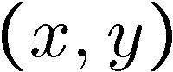
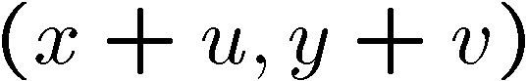
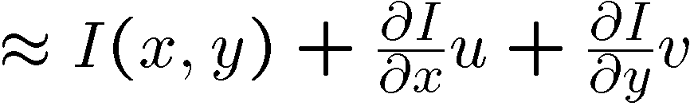
Optical flow constraints (grayscale images)
Let’s look at these constraints more closely
brightness constancy: Q: what’s the equation?
small motion:
Steve Seitz

Slide 16
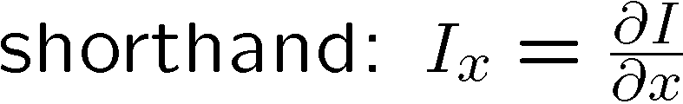


Optical flow equation
Combining these two equations
Steve Seitz

Slide 17

Optical flow equation
Q: how many unknowns and equations per pixel?
Intuitively, what does this ambiguity mean?

Slide 18
The aperture problem
Perceived motion
Notes:
The component of the flow perpendicular to the gradient (i.e., parallel to the edge) is unknown

Slide 19
The aperture problem
Actual motion

Slide 20

The barber pole illusion
http://en.wikipedia.org/wiki/Barberpole_illusion

Slide 21

The barber pole illusion
http://www.sandlotscience.com/Ambiguous/Barberpole_Illusion.htm

Slide 22
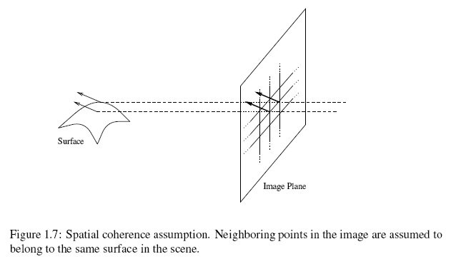
Solving the aperture problem
(grayscale image)
How to get more equations for a pixel?
Spatial coherence constraint: pretend the pixel’s neighbors have the same (u,v)
Figure by Michael Black

Slide 23
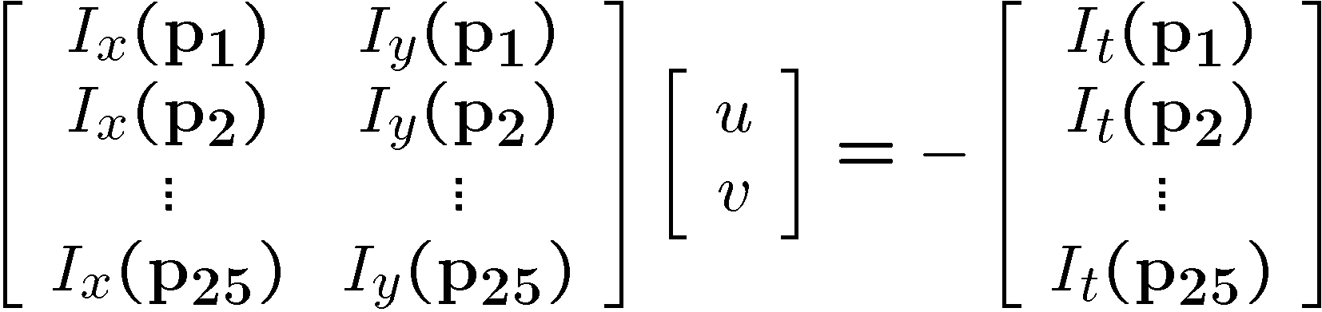




Solving the aperture problem (grayscale image)
How to get more equations for a pixel?
Spatial coherence constraint: pretend the pixel’s neighbors have the same (u,v)
If we use a 5x5 window, that gives us 25 equations per pixel
Steve Seitz

Slide 24




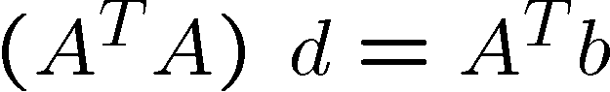

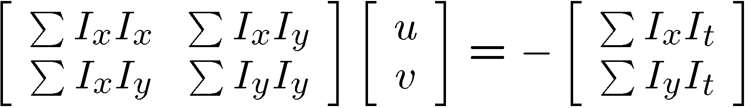

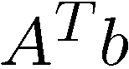
Solving the aperture problem
Prob: we have more equations than unknowns
Solution: solve least squares problem
minimum least squares solution given by solution (in d) of:
The summations are over all pixels in the K x K window
This technique was first proposed by Lucas & Kanade (1981)

Slide 25
Conditions for solvability
When is this solvable?
A^{T}A should be invertible
A^{T}A should not be too small
eigenvalues λ₁ and λ₂ of A^{T}A should not be too small
A^{T}A should be well-conditioned
λ₁/ λ₂ should not be too large (λ₁ = larger eigenvalue)
Slide by Steve Seitz, UW

Slide 26
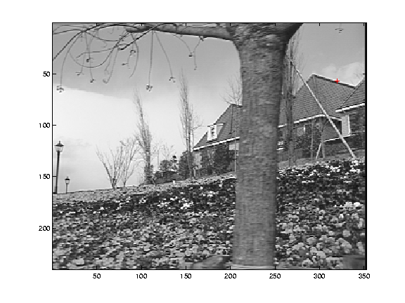
Edge
gradients very large or very small
large λ₁, small λ₂

Slide 27
Low-texture region
gradients have small magnitude
small λ₁, small λ₂

Slide 28
High-texture region
gradients are different, large magnitudes
large λ₁, large λ₂

Slide 29
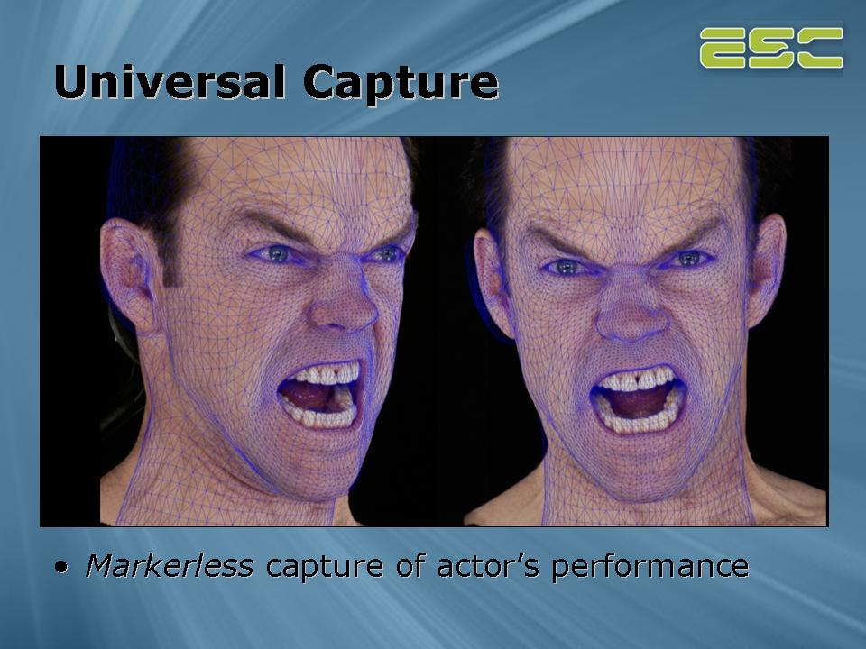
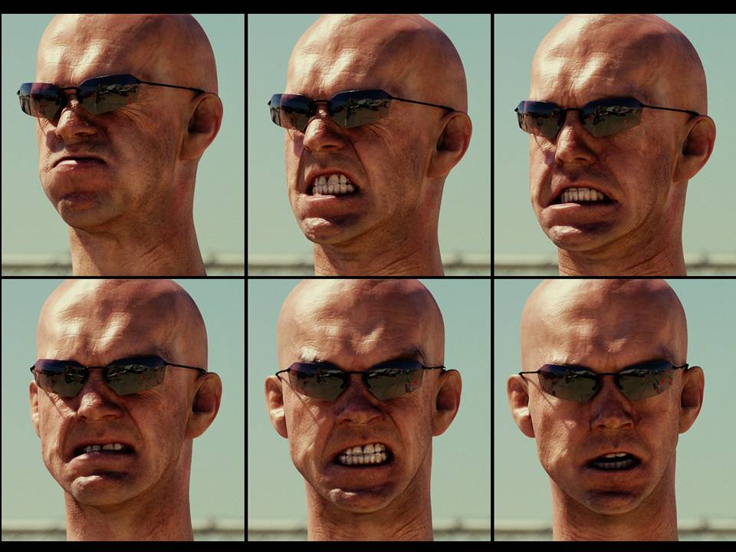
Example use of optical flow: facial animation
http://www.fxguide.com/article333.html

Slide 30
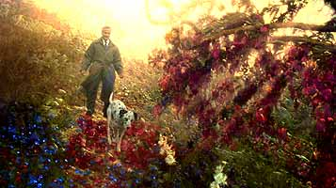
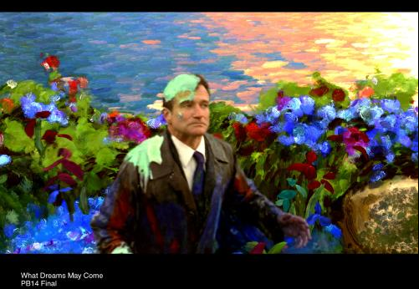
Example use of optical flow: Motion Paint
Use optical flow to track brush strokes, in order to animate them to follow underlying scene motion.
http://www.fxguide.com/article333.html

Slide 31
Fun with flow
http://www.youtube.com/watch?v=TbJrc6QCeU0&feature=related
http://www.youtube.com/watch?v=pckFacsIWg4

Slide 32
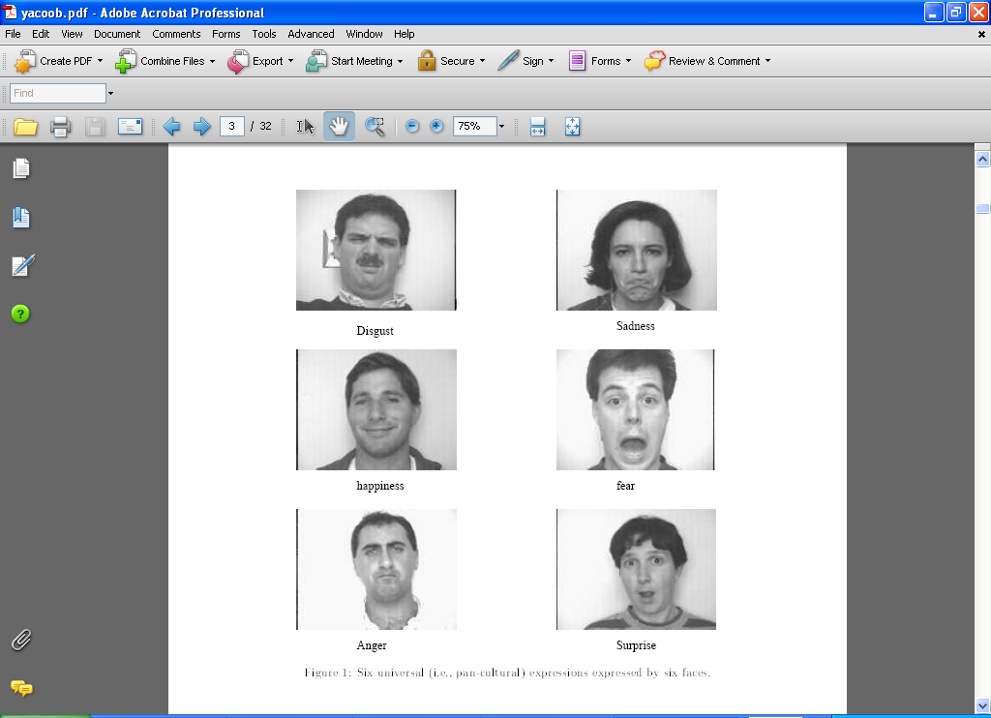
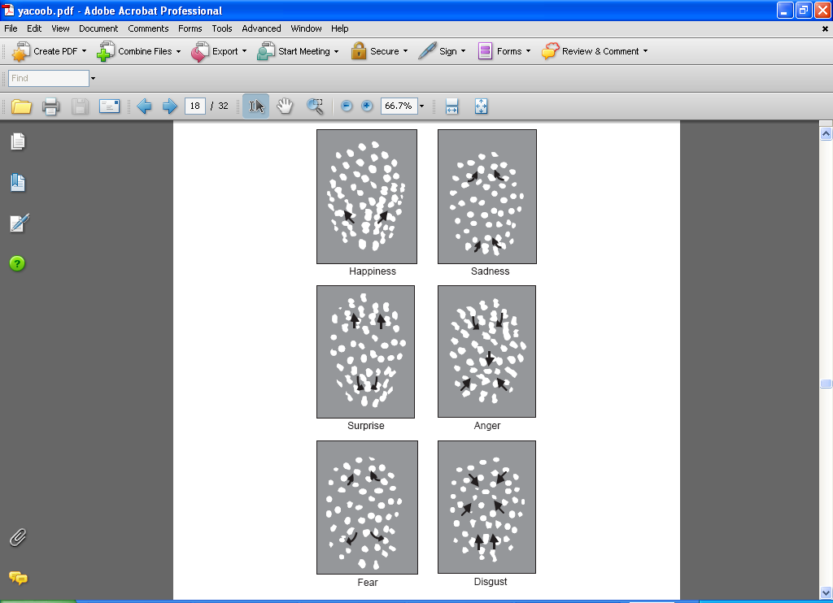
Using optical flow: recognizing facial expressions
Recognizing Human Facial Expression (1994) by Yaser Yacoob, Larry S. Davis

Slide 33
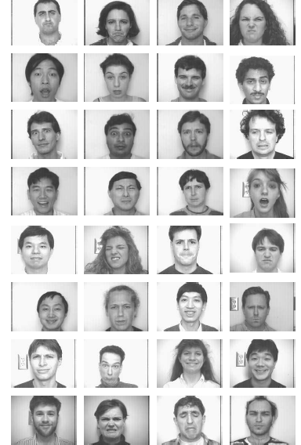
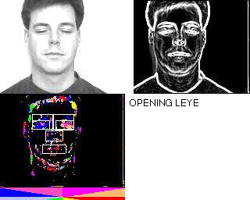
Using optical flow: recognizing facial expressions

Slide 34
Observation
This is a two image problem BUT
Can measure sensitivity by just looking at one of the images!
This tells us which pixels are easy to track, which are hard
very useful later on when we do feature tracking...

Slide 35
Errors in Lukas-Kanade
What are the potential causes of errors in this procedure?
Suppose A^{T}A is easily invertible
Suppose there is not much noise in the image
When our assumptions are violated
Brightness constancy is not satisfied
The motion is not small
A point does not move like its neighbors
window size is too large
what is the ideal window size?

Slide 36
Iterative Refinement
Iterative Lukas-Kanade Algorithm
Estimate velocity at each pixel by solving Lucas-Kanade equations
Warp H towards I using the estimated flow field
- use image warping techniques
Repeat until convergence

Slide 37
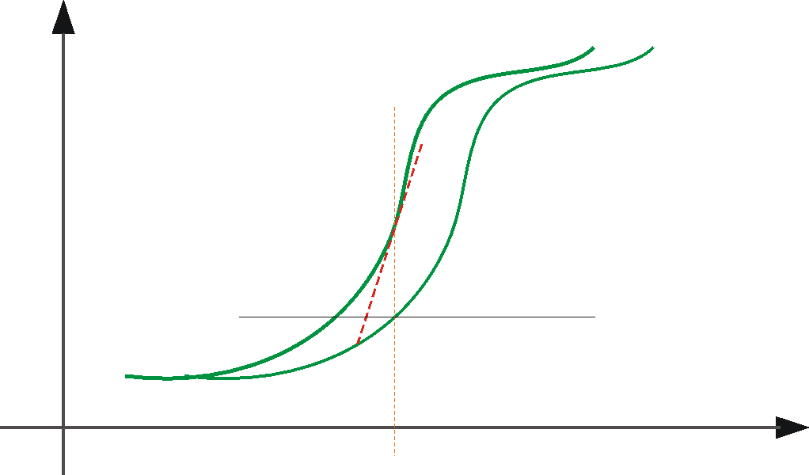
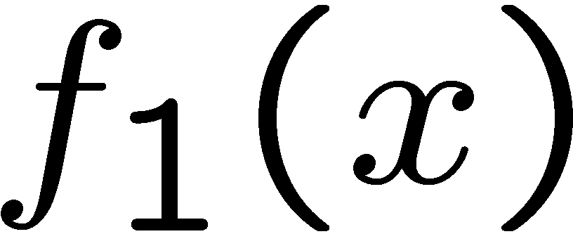
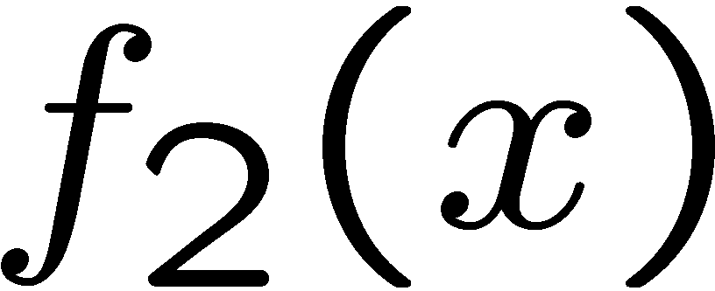


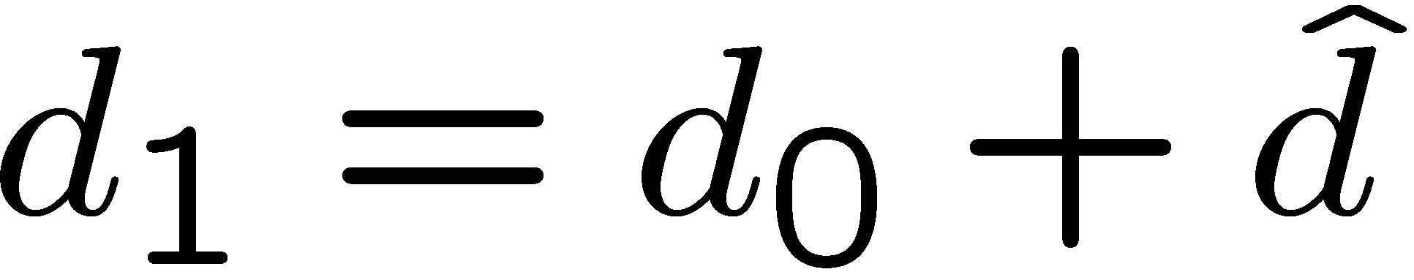
Optical Flow: Iterative Estimation
estimate update
Initial guess:
Estimate:
x₀
x
(using d for displacement here instead of u)

Slide 38
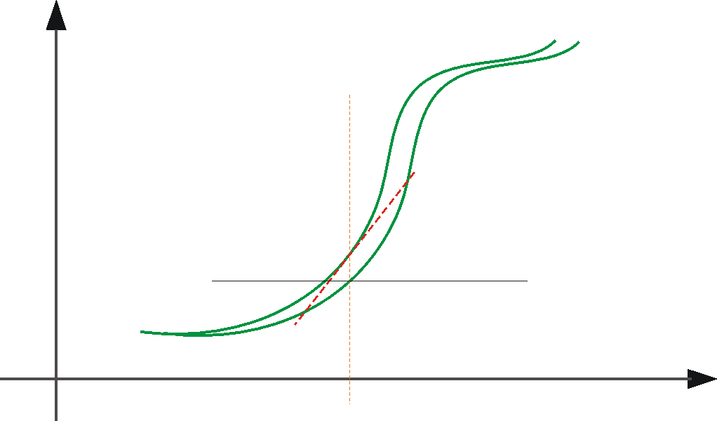
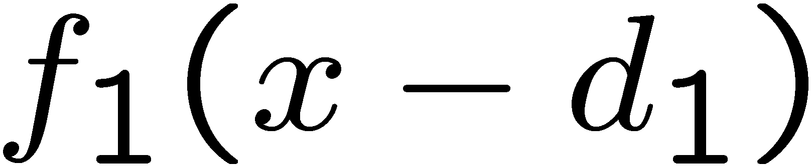
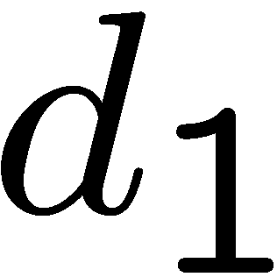
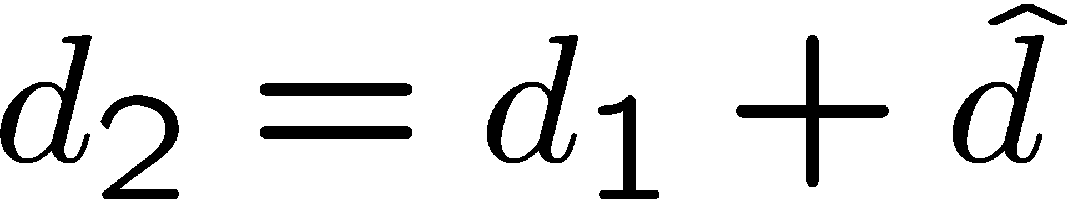
Optical Flow: Iterative Estimation
estimate update
Initial guess:
Estimate:
x₀
x

Slide 39
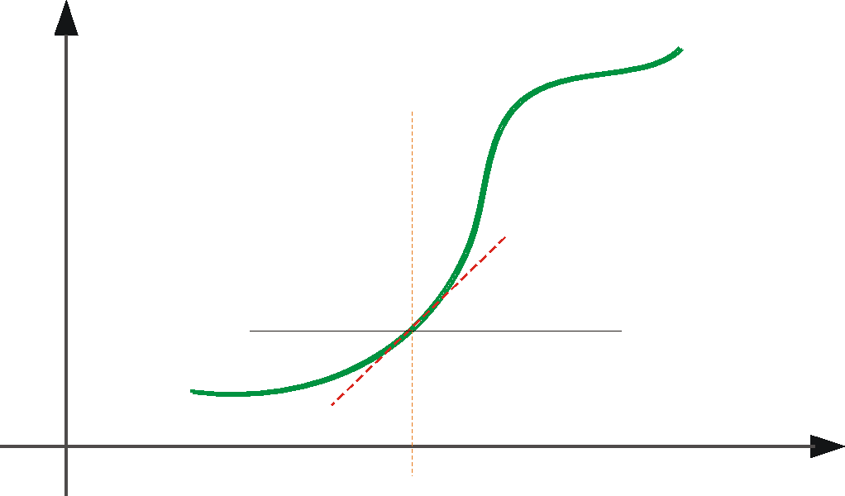
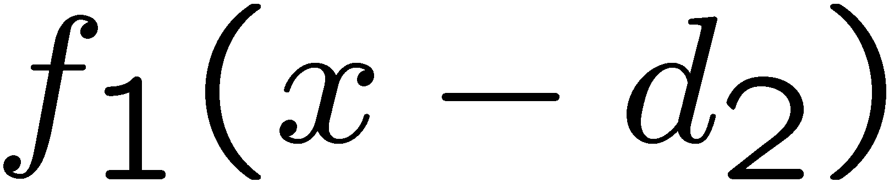
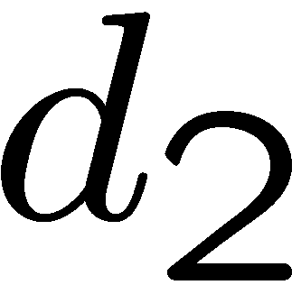
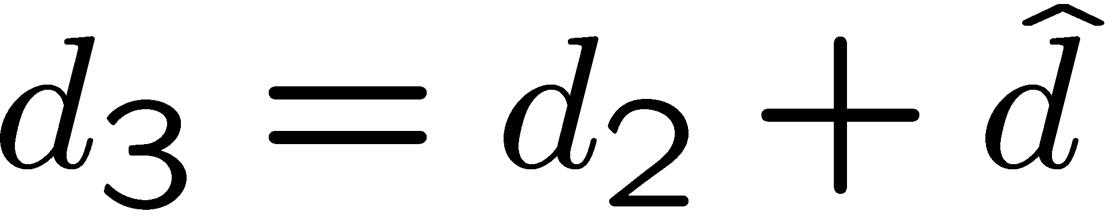
Optical Flow: Iterative Estimation
estimate update
Initial guess:
Estimate:
Initial guess:
Estimate:
x₀
x

Slide 40
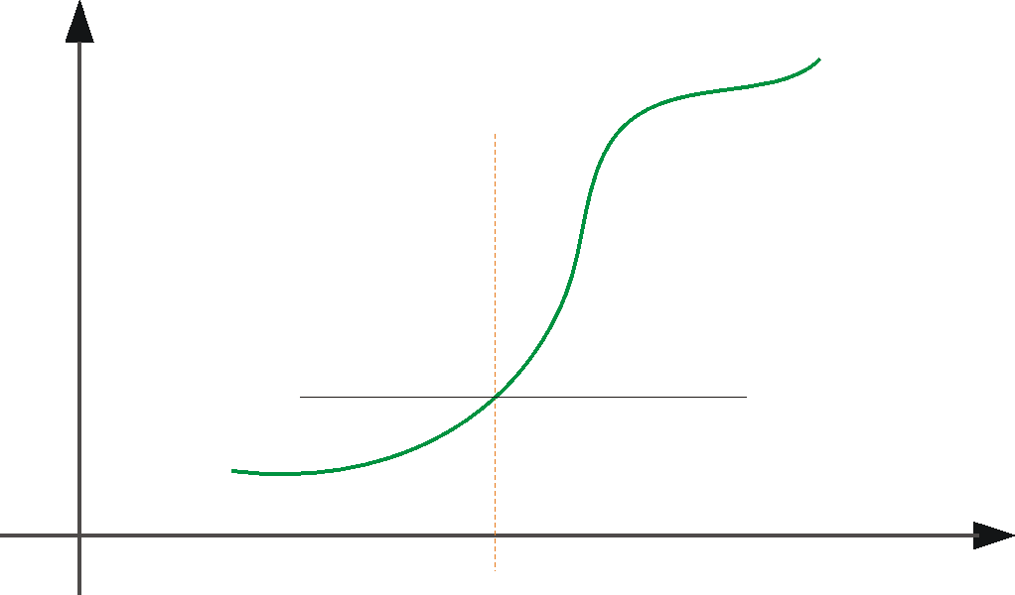
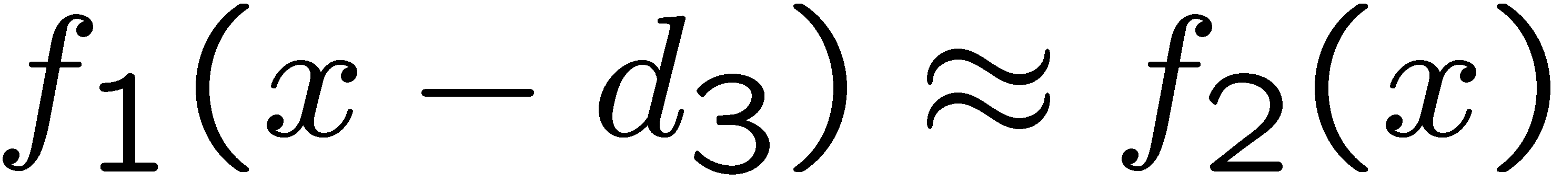
Optical Flow: Iterative Estimation
x₀
x

Slide 41
Optical Flow: Iterative Estimation
Some Implementation Issues:
Warping is not easy (ensure that errors in warping are smaller than the estimate refinement)
Warp one image, take derivatives of the other so you don’t need to re-compute the gradient after each iteration.
Often useful to low-pass filter the images before motion estimation (for better derivative estimation, and linear approximations to image intensity)

Slide 42
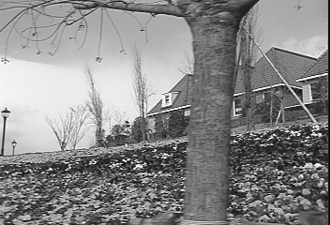
Revisiting the small motion assumption
Is this motion small enough?
Probably not—it’s much larger than one pixel (2nd order terms dominate)
How might we solve this problem?

Slide 43
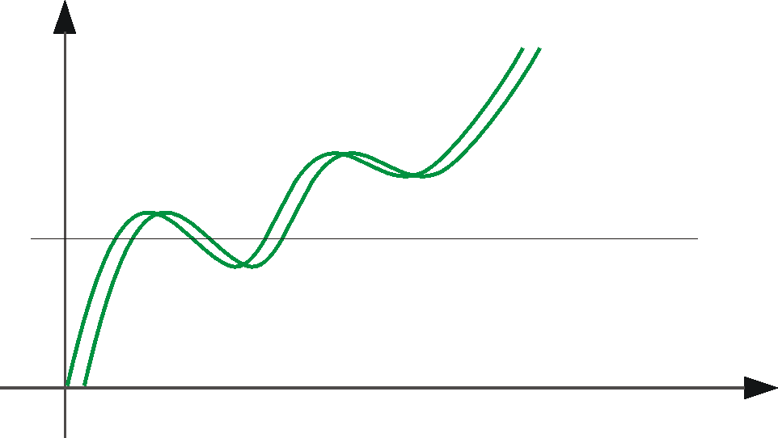
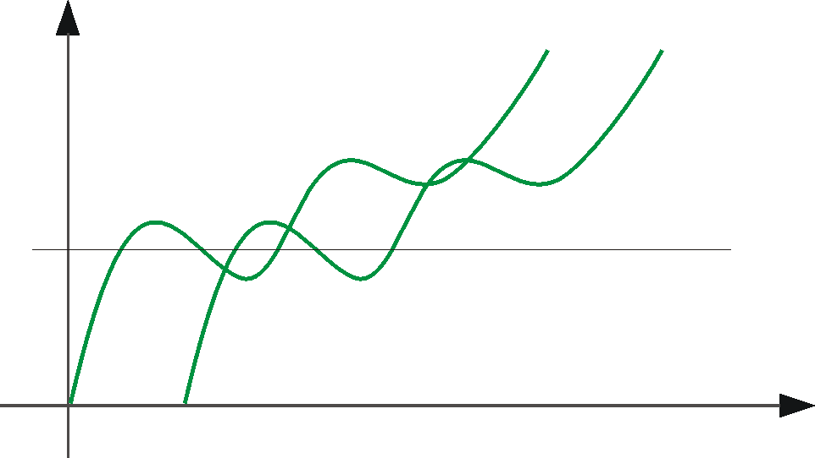
Optical Flow: Aliasing
Temporal aliasing causes ambiguities in optical flow because images can have many pixels with the same intensity.
I.e., how do we know which ‘correspondence’ is correct?
actual shift
estimated shift
nearest match is correct (no aliasing)
nearest match is incorrect (aliasing)
To overcome aliasing: coarse-to-fine estimation.

Slide 44
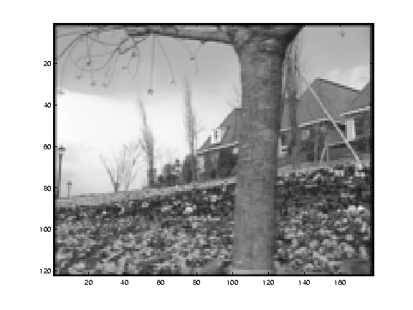
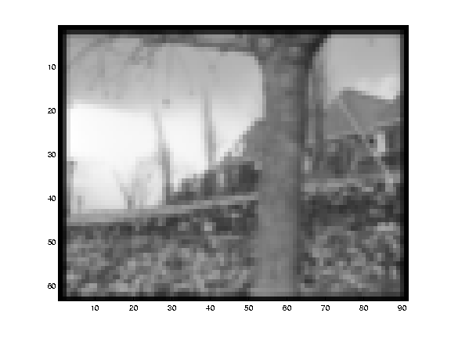
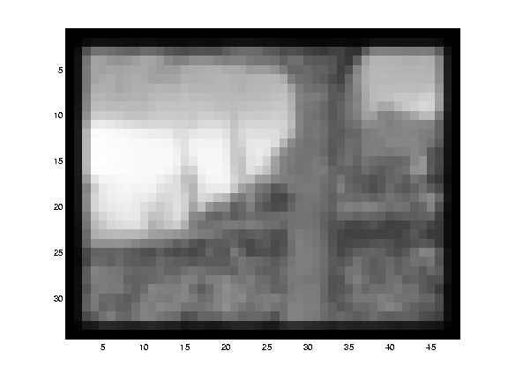
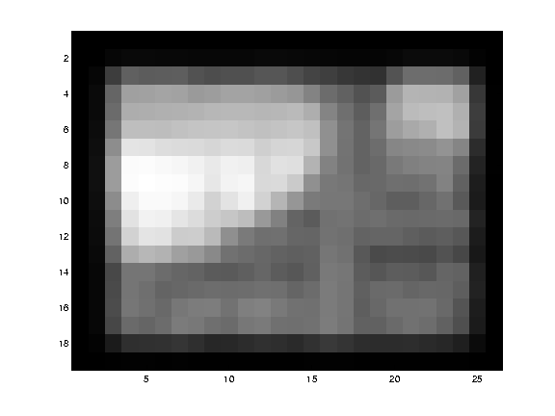
Reduce the resolution!

Slide 45
Coarse-to-fine optical flow estimation
u=1.25 pixels
u=2.5 pixels
u=5 pixels
image H
u=10 pixels
image I
image H
image I
Gaussian pyramid of image H
Gaussian pyramid of image I

Slide 46
Coarse-to-fine optical flow estimation
run iterative L-K
warp & upsample
run iterative L-K
.
.
.
image J
image I
image H
image I
Gaussian pyramid of image H
Gaussian pyramid of image I

Slide 47
Beyond Translation
So far, our patch can only translate in (u,v)
What about other motion models?
rotation, affine, perspective
Same thing but need to add an appropriate Jacobian
See Szeliski’s survey of Panorama stitching

Slide 48
Classes of Techniques
Feature-based methods (e.g. SIFT+Ransac+regression)
Extract visual features (corners, textured areas) and track them over multiple frames
Sparse motion fields, but possibly robust tracking
Suitable especially when image motion is large (10-s of pixels)
Direct-methods (e.g. optical flow)
Directly recover image motion from spatio-temporal image brightness variations
Global motion parameters directly recovered without an intermediate feature motion calculation
Dense motion fields, but more sensitive to appearance variations
Suitable for video and when image motion is small (< 10 pixels)

Slide 49

Block-based motion prediction
Break image up into square blocks
Estimate translation for each block
Use this to predict next frame, code difference (MPEG-2)

Slide 50

Optical Flow Algorithm
Shi/Tamosi – Good Features to Track
Pyramidal Lucas Kanade – Feature Tracking

Slide 51



Unwanted Features

Slide 52
Extended Optical Flow Algorithm
Goal
Eliminate Unwanted Features
Generating low dimensionality of feature data
Ensuring quality of the data to be employed for Human action recognitions
Definitions
Unwanted Features –> All the Features that are tracked outside the person and certain features that are tracking on the person.
Useful Features - >Features that show considerable movement in their position spatially with respect to a sequence of images
Techniques
Frame Jump -> To determine the useful features
Feature selection using Threshold -> To remove the unwanted features
Feature extraction

Slide 53
Frame Jump
Tracking all the good features in one Frame (F) using Shi/Tamosi Algorithm.
Good features include both Noisy and Useful features.
Apply Frame Jump Algorithm
given F(i)^{th} frame among a sequence of video frames
N : the number of frames that we foresee
output G(i)th frame to be determined for comparison
Initialization k ← N/n : k – the scaling factor
n – Frame Max
1: for all video frames ( i = 1 to N) do
2: if ((F(i) +N / k) ≤ N) then
3: G(i) ← F(i) + N / k
4: else
5: k ← k + 1
6: G(i) ← F(i) + N / k
7: end if
8: end for
Track the “tracked good features” from F in G using Pyramidal Lucas Canade Algorithm

Slide 54


Frame Jump
Without Frame Jump Algorithm
With Frame Jump Algorithm

Slide 55
Feature Selection
Threshold setting
Input F(1)^{st} frame among a sequence of video frames
N : the number of frames that we foresee
D : Distance of separation initialized to 0.
Output Threshold value t
1: for all video frames ( i = 1 to N) do
2.
3: i ← i + 1
4: end for
4: t = D/N
Unwanted Feature Elimination:
Select the features whose distance of separation is more than the threshold t.
Eliminate it otherwise

Slide 56

Unwanted Feature Elimination

Slide 57

Extended Optical Flow

Slide 58
Feature Extraction
X and Y Coordinates
Average of the qualified features
Speed of the action
Distance of the qualified features in a frame/Time taken to process the frame.
Euclidean distance of movement
Direction of the action
Form bins for 8 directions
Allocate a bin for each frame based on the qualified features

Slide 59


Feature Extraction
X and Y Coordinates
X.Data = [Sum(F(i).x)] / N
Y.Data = [Sum(F(i).y)]/N

Slide 60
Applications of Frame Jump Technique
Can be used as a Background Subtraction method.
Flexibility to use it with other Feature Extraction Techniques.
Removes redundant information about the features.
Easy to implement and computationally inexpensive

Slide 61
Motion vs. Stereo: Similarities
Both involve solving
Correspondence: disparities, motion vectors
Reconstruction

Slide 62
Motion vs. Stereo: Differences
Motion:
Uses velocity: consecutive frames must be close to get good approximate time derivative
3d movement between camera and scene not necessarily single 3d rigid transformation
Whereas with stereo:
Could have any disparity value
View pair separated by a single 3d transformation

Slide 63

Video as an “Image Stack”
time
255
0
t
Can look at video data as a spatio-temporal volume
If camera is stationary, each line through time corresponds to a single ray in space
Alyosha Efros, CMU

Slide 64

Input Video
Alyosha Efros, CMU

Slide 65

Average Image
Alyosha Efros, CMU

Slide 66

Slide credit: Birgi Tamersoy

Slide 67
Background subtraction
Simple techniques can do ok with static camera
…But hard to do perfectly
Widely used:
Traffic monitoring (counting vehicles, detecting & tracking vehicles, pedestrians),
Human action recognition (run, walk, jump, squat),
Human-computer interaction
Object tracking

Slide 68

Slide credit: Birgi Tamersoy

Slide 69

Slide credit: Birgi Tamersoy

Slide 70

Slide credit: Birgi Tamersoy

Slide 71

Slide credit: Birgi Tamersoy

Slide 72

Frame differences vs. background subtraction
Toyama et al. 1999

Slide 73

Slide credit: Birgi Tamersoy

Slide 74






Average/Median Image
Alyosha Efros, CMU

Slide 75







Background Subtraction
-
=
Alyosha Efros, CMU

Slide 76
Pros and cons
Advantages:
Extremely easy to implement and use!
All pretty fast.
Corresponding background models need not be constant, they change over time.
Disadvantages:
Accuracy of frame differencing depends on object speed and frame rate
Median background model: relatively high memory requirements.
Setting global threshold Th…
When will this basic approach fail?
Slide credit: Birgi Tamersoy

Slide 77


Background mixture models
Idea: model each
background pixel with a mixture of Gaussians;
update its parameters over time.
Adaptive Background Mixture Models for Real-Time Tracking,
Chris Stauer & W.E.L. Grimson

Slide 78

Background subtraction with depth
How can we select foreground pixels based on depth information?

Slide 79
Human activity in video
No universal terminology, but approximately:
“Actions”: atomic motion patterns -- often gesture-like, single clear-cut trajectory, single nameable behavior (e.g., sit, wave arms)
“Activity”: series or composition of actions (e.g., interactions between people)
“Event”: combination of activities or actions (e.g., a football game, a traffic accident)
Adapted from Venu Govindaraju

Slide 80

Surveillance
http://users.isr.ist.utl.pt/~etienne/mypubs/Auvinetal06PETS.pdf

Slide 81

Interfaces
2011

Slide 82

Interfaces
2011
1995
W. T. Freeman and C. Weissman, Television control by hand gestures, International Workshop on Automatic Face- and Gesture- Recognition, IEEE Computer Society, Zurich, Switzerland, June, 1995, pp. 179--183. MERL-TR94-24
Notes:
www.botsquare.com

Slide 83
Human activity in video: basic approaches
Model-based action/activity recognition:
Use human body tracking and pose estimation techniques, relate to action descriptions (or learn)
Major challenge: accurate tracks in spite of occlusion, ambiguity, low resolution
Activity as motion, space-time appearance patterns
Describe overall patterns, but no explicit body tracking
Typically learn a classifier
We’ll look at some specific instances…

Slide 84

Motion and perceptual organization
Even “impoverished” motion data can evoke a strong percept

Slide 85
Motion and perceptual organization
Even “impoverished” motion data can evoke a strong percept

Slide 86

Motion and perceptual organization
Even “impoverished” motion data can evoke a strong percept
Video from Davis & Bobick

Slide 87

Using optical flow: action recognition at a distance
Features = optical flow within a region of interest
Classifier = nearest neighbors
Challenge: low-res data, not going to be able to track each limb.
The 30-Pixel Man
[Efros, Berg, Mori, & Malik 2003]
http://graphics.cs.cmu.edu/people/efros/research/action/

Slide 88



Using optical flow: action recognition at a distance
Correlation-based tracking
Extract person-centered frame window
[Efros, Berg, Mori, & Malik 2003]
http://graphics.cs.cmu.edu/people/efros/research/action/

Slide 89


Using optical flow: action recognition at a distance
Extract optical flow to describe the region’s motion.
[Efros, Berg, Mori, & Malik 2003]
http://graphics.cs.cmu.edu/people/efros/research/action/

Slide 90

Using optical flow: action recognition at a distance
Input
Sequence
Matched
Frames
Use nearest neighbor classifier to name the actions occurring in new video frames.
[Efros, Berg, Mori, & Malik 2003]
http://graphics.cs.cmu.edu/people/efros/research/action/

Slide 91

Using optical flow: action recognition at a distance
Input
Sequence
Matched NN
Frame
Use nearest neighbor classifier to name the actions occurring in new video frames.
[Efros, Berg, Mori, & Malik 2003]
http://graphics.cs.cmu.edu/people/efros/research/action/

Slide 92

Do as I do: motion retargeting
[Efros, Berg, Mori, & Malik 2003]
http://graphics.cs.cmu.edu/people/efros/research/action/

Slide 93
Motivation
Even “impoverished” motion data can evoke a strong percept

Slide 94



Motion Energy Images
D(x,y,t): Binary image sequence indicating motion locations
Davis & Bobick 1999: The Representation and Recognition of Action Using Temporal Templates

Slide 95

Motion Energy Images
Davis & Bobick 1999: The Representation and Recognition of Action Using Temporal Templates

Slide 96

Motion History Images
Davis & Bobick 1999: The Representation and Recognition of Action Using Temporal Templates

Slide 97



What is Shape?
The shape of the object is a binary image representing the extent of the object
The shape can be thought of as a silhouette of the object
There are many imaging applications where image analysis can be reduced to the analysis of shapes

Slide 98
Shape Matching Problem
What you read this?

Slide 99
Shape Matching Problem
What is this?
Sun? ball? walnut?!!...
We need color, texture, …

Slide 100

Topological Attributes
Topological shape attributes are properties of a shape that are invariant under rubber-sheet transformation

Slide 101
Simple Geometrical Shape Parameters
A(X) is the area of the figure X
P(X) is the perimeter of the figure X
D_{A}(X) and D_{P}(X) P are the diameters of circles with area A(X) and with perimeter P(X) , respectively

Slide 102

Simple geometrical shape parameters
F_{x}(X) , F_{y}(X) are the orthogonal projections of the figure X on the x and y axes.
F_{min}(X) and F_{max}(X) are the minimal and the maximal orthogonal projections of the figure on a line.

Slide 103

Simple Geometrical Shape Parameters
star X is the part of X seen from a random point in X
this parameter is useful when physically important point in the figure X is chosen to be the origin point

Slide 104

Simple Geometrical Shape Parameters
R_{in}(X) and R_{out}(X) are the radii of the largest disc in X and the smallest disc which completely includes X

Slide 105
Simple Geometrical Shape Parameters
and are the coordinates of the center of gravity (also called center of mass or centroid)
they are determined just by averaging the coordinates of each point of the figure X as

Slide 106
Basic Measurements
Circularity ratio: the ratio of the area of the shape to the area of a circle (the most compact shape) having the same perimeter. (area-perimeter ratio)
For a circle, the ratio is one; for a square, it is π / 4; for an infinitely long and narrow shape, it is zero.

Slide 107
Basic Measurements
Wadell's circularity shape ratio
is also equal to 1 for a disc, otherwise it is less than 1.
Drainage-basin circularity shape ratio
It is equal to 1 for a disc, otherwise it is less than 1.

Slide 108
Basic Measurements
Another Wadell's ratio which defines degree of circularity, is :
Actually, it is just the square root of the area-perimeter ratio. The reciprocal of this expression is the Horton's compactness factor.

Slide 109


Shape Description
Shape description refers to the methods that result in a numeric descriptor of the shape
A shape description method generates a shape descriptor vector (also called a feature vector) from a given shape
The goal of description is to uniquely(?) characterize the shape using its shape descriptor vector.
The required properties of a shape description scheme are invariance to translation, scale, and rotation.

Slide 110
Moment Invariants
The regular moment of a shape in an M by N binary image is defined as:
f(x,y) is the intensity of the pixel (either 1 or 0) at the coordinates (x,y)
p+q is said to be the order of the moment.

Slide 111
Moment Invariants
The regular moment of a shape in an M by N binary image is defined as:
M00: area/volume, #pixels if binary image
M10: sum over x
M01: sum over y

Slide 112
Moment Invariants
To remove translational variability :
distance between shape pixels and the origin measurements are taken relative to the shapes centroid (x’,y’)
The coordinates of the centroid:
Relative moments are then calculated using the equation for central moments

Slide 113



Moment Invariants
Individual moments values do not have the descriptive power to uniquely represent arbitrary shapes
sets of functions based on these moments can be determined which do
Hu derived a set of seven rotational invariant moment functions which form a suitable shape representation
…

Slide 114

Shape Skeletons
The skeleton of a binary shape is obtained by repeatedly thinning until it becomes a unit pixel width network

Slide 115
Shape Skeletons
The philosophy behind the skeleton approach to object recognition is that most of the information about a particular shape is contained within its topology.
Consider the case of hand-drawn characters
Generation of the Skeletal Graph
Graph Matching

Slide 116
Log-Polar Mapping
This scheme maps points in the image space to points in the log-polar parameter space
Consider a point z in the image space where z = x + yj,
The log-polar mapping will map to a point w in the parameter space, where:
or
The invariant nature of the mapping arises because changes in scale and orientation in the image space are mapped to translations in the parameter space.

Slide 117

Log-Polar Mapping
The mapping of scale to translation can easily be demonstrated using the one dimensional case:

Slide 118
Log-Polar Mapping
The log-polar mapping does not introduce scale and rotation invariance, by simplifying these modes of variation to translation the invariance can more easily be achieved.
Wechsler et al take the Fourier Transform of the log-polar space and use its magnitude as an invariant.
Because the representation is not intrinsically translation invariant the shape being analyzed first has to be moved to the centre of view.

Slide 119
Log-Polar Mapping
small variations in located centroid result indramatic variations in the resulting log-polar representation.
random noise and occlusion produce such variations.
singularity of log-polar mapping at log(0)

Slide 120

Geometric Shape Descriptors
Strachan et al use a simple geometric shape descriptor to automatically classify different fish species. Their descriptor consists of eleven length measurements taken from fish profiles

Slide 121




Image moments
Use to summarize shape given image I(x,y)
Central moments are translation invariant:

Slide 122
Hu moments
Set of 7 moments
Apply to Motion History Image for global space-time “shape” descriptor
Translation and rotation invariant

Slide 123

Pset 5
Depth map sequence
Motion History Image
Nearest neighbor action classification with Motion History Images + Hu moments

Slide 124
Summary
Background subtraction:
Essential low-level processing tool to segment moving objects from static camera’s video
Action recognition:
Increasing attention to actions as motion and appearance patterns
For instrumented/constrained environments, relatively simple techniques allow effective gesture or action recognition

Slide 125

Hu moments

